Slide 1
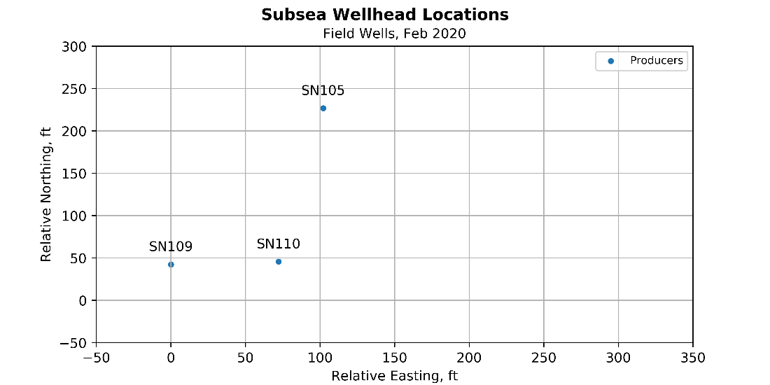
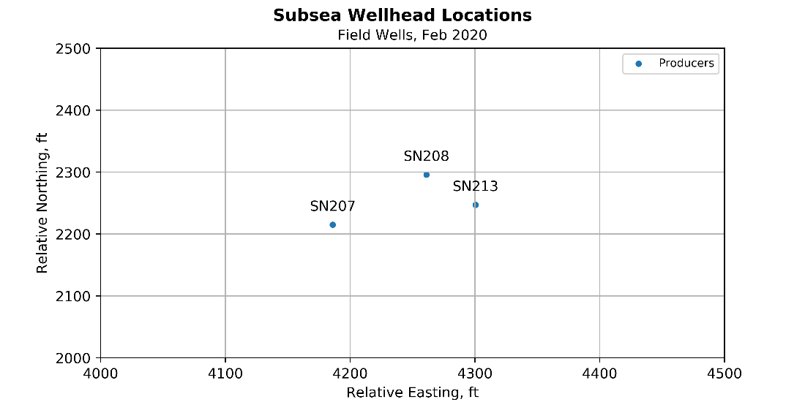
Well Locations (Updated))
Relative locations of SN200 series well based on SN100 series wells
001, based on directional data

Slide 2
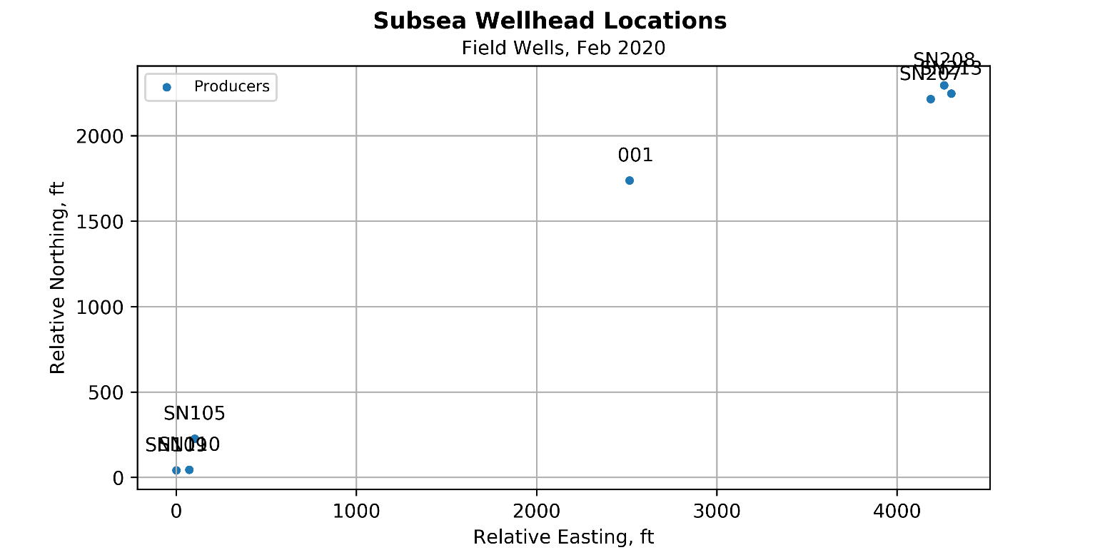
Well Locations (Superseded)
Lat long in API list may not be representative; See directional data location below
001aaa, based on directional data

